Slide 1
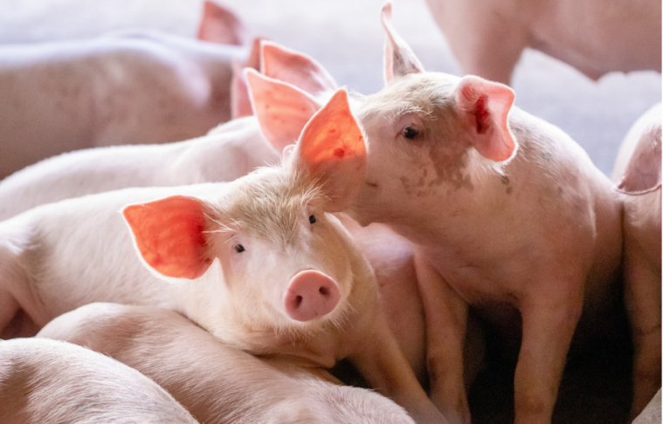
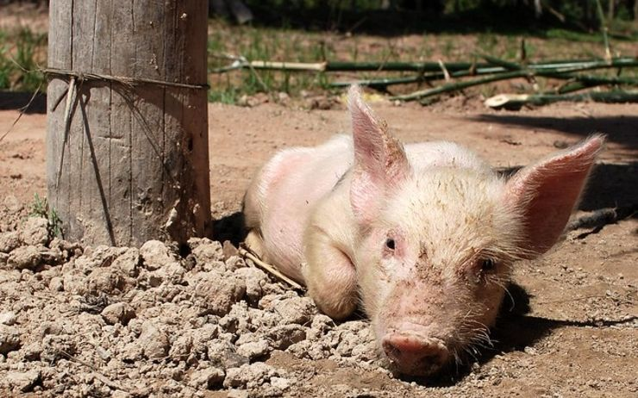
African Swine Fever (ASF) in Togo and research perspectives
Dr YEMPABOU Damitoti

Slide 2
Outlines
The Size and importance of the pig industry
ASF situation in Togo
Main challenges as regards ASF control
On going ASF research

Slide 3
Size and importance of the hog industry
Source (DSID, 2012 ; Estimations de la DE, 2021)
Figure 1 : Evolution of the Togolese pig population by region

Slide 4
The ASF situation in Togo
Last 3 decades ➔ Togo: Outbreats of ASF ➔ Huge losses
After the waves of ASF in 1997 ➔ Disease in all regions
All economic regions of Togo were affected between 1997 and 2006
Despite the control measures applied in the different regions, ASF reappeared in 2009 and remains endemic today
In jun 2019➔ The most important wave : 31 reported outbreaks
During the same year, 1000 cases were notified in a population at risk of 3000 pigs and 600 were destroyed by the veterinary services

Slide 5
Main challenges in controlling ASF
Lack of ASF virus genotyping studies
Lack of funding for further studies
Poorly equipped laboratory

Slide 6
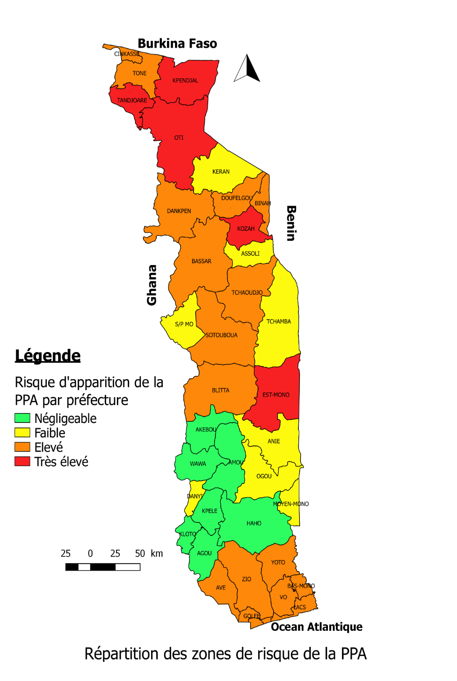
Ongoing ASF Research
Diagnose and map areas at risk of ASF outbreak by highlighting high risk areas as well as high production areas including animal movement at the national and sub regional level
Develop an emergency response plan against African Swine Fever (ASF) in Togo, including the control of animal movements

Slide 7
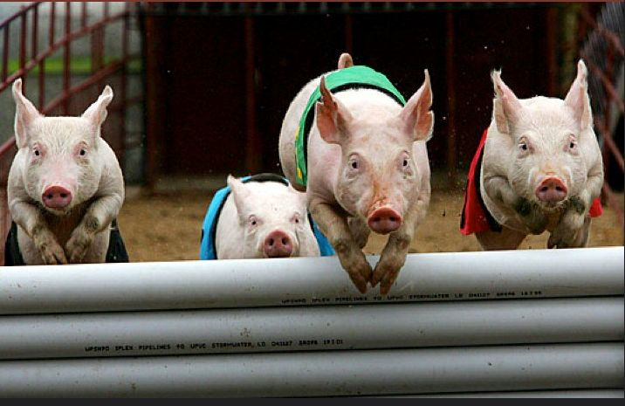
THANKS

